Slide 1
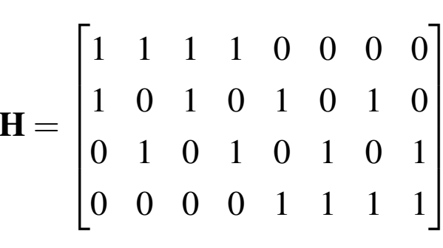


Block length n
$$d_{c}=4$$
$$d_{v}=2$$

